Slide 1
Visual simulator for high quality planning domain models
Software Engineering 2: Project Teamwork Mälardalen University
Group #2
Client : Ericsson
Contact : Swarup Kumar Mohalik

Slide 2
What we have done so far
Talked to Swarup via Skype
Started writing a requirements document
Set up a Git repository
First week of using Trello
Decided on routines for the group work
Initial PDDL research

Slide 3
What are we doing this week
Finish the project plan
PDDL research, making a small test project
Implementation design

Slide 4
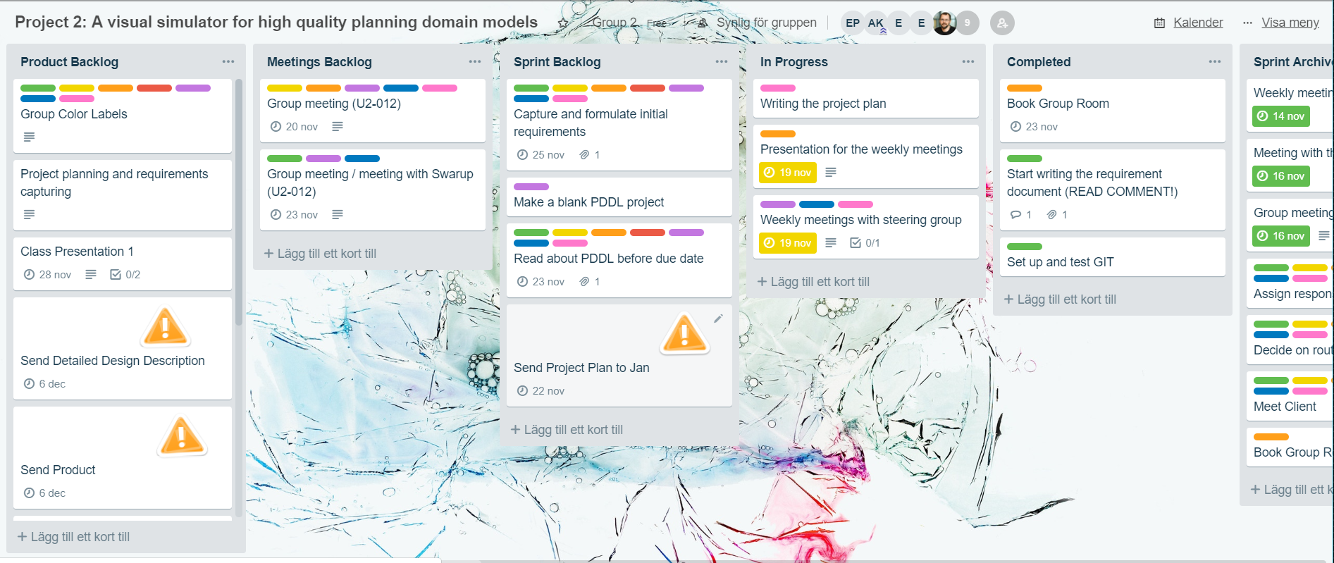
Our Trello board right now

